Slide 1


United states progress in vaccination
Grant Bauer

Slide 2

How is America handling covid vaccinations?
A look at the
National level
Regional level
State level

Slide 3
Project Questions
What is the subject you are analyzing?
- The subject is the vaccination rate of the US on a national and state level.
What data will you use?
- I used data on vaccinations rate from state by state from January to May.
How did you collect the data?
- I found the data on Kaggle. Source
What work did you do in the project?
- I combined different sets and categories of data to get National, Regional and State level.
What tools did you use to accomplish your output?
- I used calculated field and trajectory tools.
What is the story your project is telling?
- The story I’m telling is how the US is doing with vaccinations and where it can improve.

Slide 4
The national level perspective
January - May

Slide 5
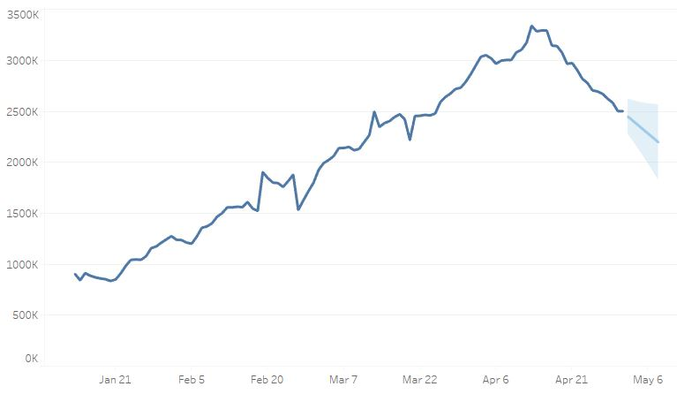
National trajectory of vaccinations
The United States is currently on a downward trajectory and, according to Tableau, is bound to stay that way. The country peaked at just over 3.3 million doses given in one day and since then has been on a sharp decline.

Slide 6
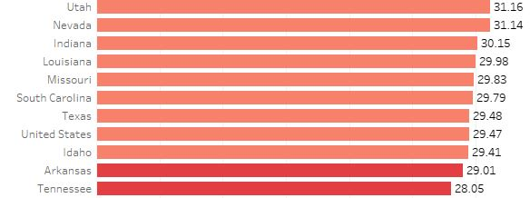
National Vaccination rate compared to individual states
The national vaccine rate compares poorly when shown against individual states. In fact, the rate if the United States rate of vaccination was a state it would be near the bottom.

Slide 7
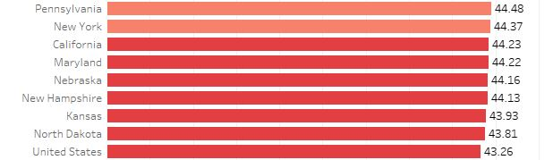
National Distribution rate per 100 compared to states
The United States distribution rate is even farther down the list than the actual rate of vaccination when compared to other states. The US would rank 25th in the country if it was a state.

Slide 8
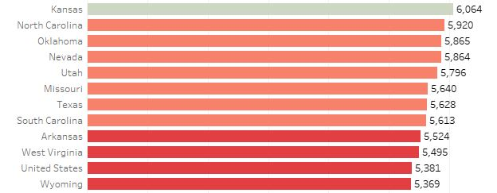
National daily vax rate per million compared to state
Despite the color change the US is even further down the list of vaccinations per million. If it were a state, the US would rank 40th on rate of vaccination.

Slide 9
Regional Level Perspective
January - May

Slide 10
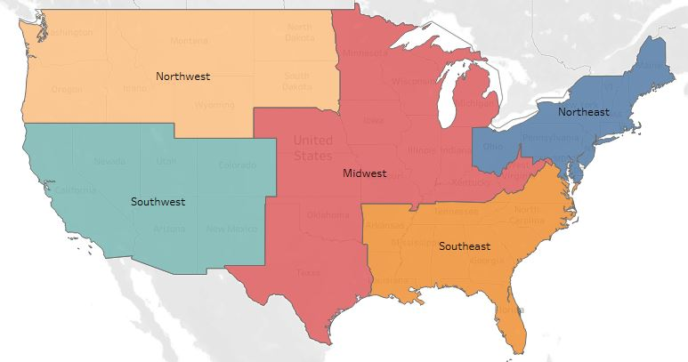
The united states broken down into regions
The following graph is a representation of the US broken down into five distinct regions based on geography. This map is also what the following section is based off.

Slide 11
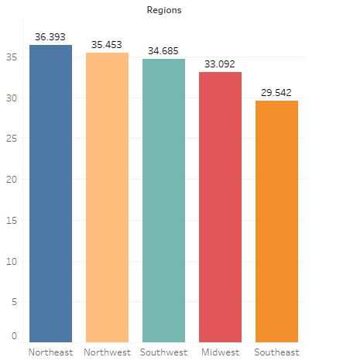
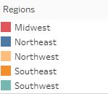
Break down of regions by percent of vaccinated
The following graph represents each region’s percent of the population vaccinated. While northeast has only a small lead to remain number in the top spot, it has a significant lead on the least vaccinated region, which is the southeast.

Slide 12
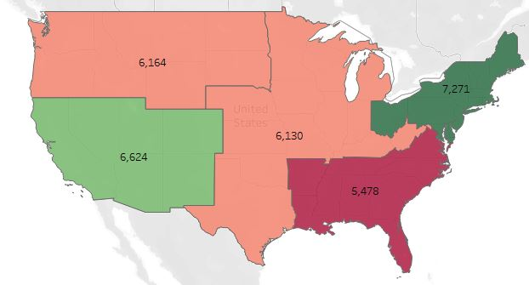
Daily vaccination rate per million by region
Northwest
Midwest
Northeast
The rate of daily vaccination per million differs slightly from the percent of each region vaccinated. The southwest region jumps the northwest region slightly. This signals that while the southwest region might have a slightly lower percent of people vaccinated as time goes on that may switch.
Southwest
Southeast

Slide 13
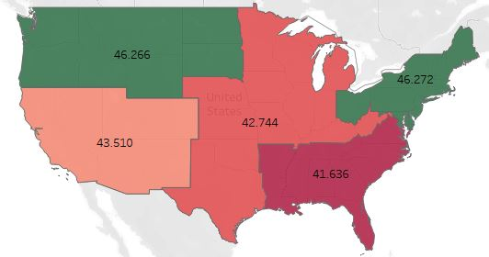
Break down of regions with each state’s percent of vaccines distributed
Northwest
Midwest
Northeast
However, the distribution of vaccines falls almost perfectly in line with the percent of each region vaccinated.
Southwest
Southeast

Slide 14
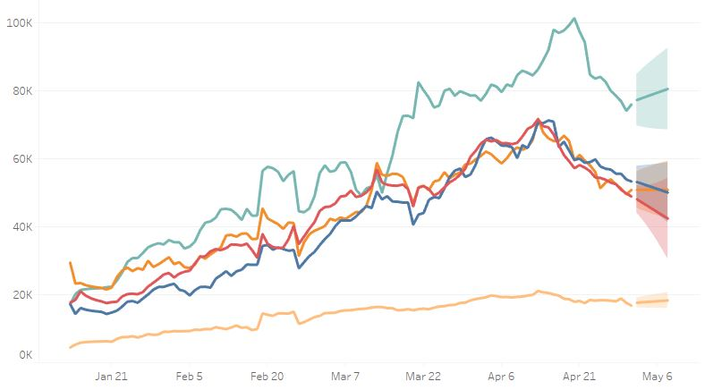
Daily vax forecast by region
Even though the Northeast region leads in percent of population vaccinated it’s projected to keep decreasing in vaccines given. However, the southwest and southeast are projected to grow. This makes sense as the Southeast has more room to grow, but the Midwest is an outlier. The Midwest ranks 4th of all the regions in percentile vaccinated but is projected to keep decreasing.

Slide 15
State level perspective
January – May

Slide 16
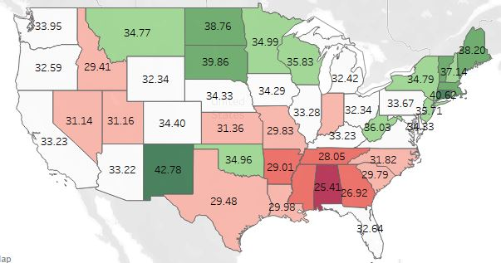
Percent of each state vaccinated
The states performing the best with the percent of their population vaccinated has a concentration in the Northeast with other states following closely spread out. However, the states doing the worst have a clear concentration in the southeast part of the country.
Alaska - 41.94
Hawaii – 36.87

Slide 17
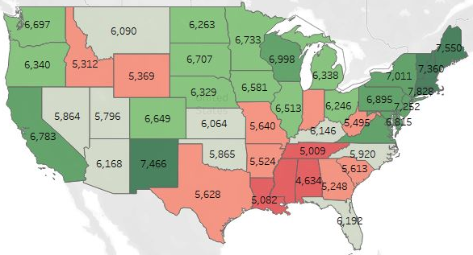
Number of daily vaccinations per state
The states with the highest average number of daily vaccines given is nearly a mirror image of the previous map. However, it is easy to see the northeast has an even higher concentration of positive results when it comes to daily vaccinations than percent vaccinated.
Alaska - 6531
Hawaii - 7644

Slide 18
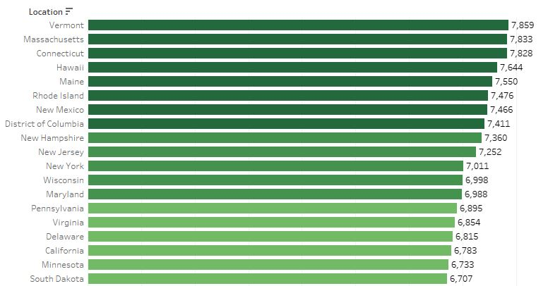
Highest performing states by daily vaccination
Vermont has a narrow lead for the highest daily vaccination rate per 100 thousand. Vermont is followed closely by Massachusetts, Connecticut, Hawaii and several other smaller states. Though the top 5 states are smaller in geographic size their overall populations are not. This combination leads to a higher population density, which is most likely a factor in their efficiency.

Slide 19
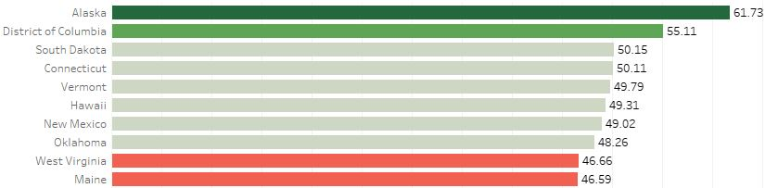
Average distribution by state
Alaska has the highest rate of distribution by state and the lead is significant. Somewhat surprisingly even though each of the top performing states have small populations their geographic size varies widely.

Slide 20
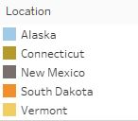
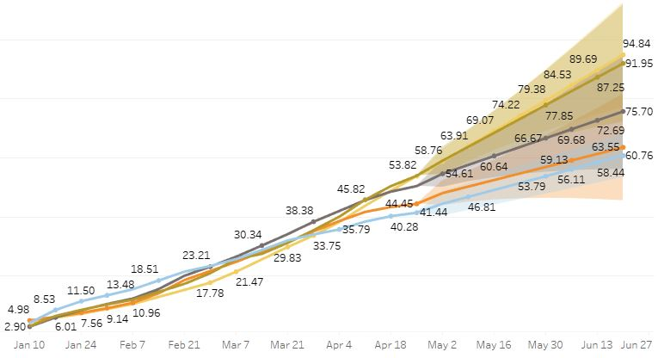
States with the highest projected vaccinated population
The states with the highest number of vaccines per 100k are Alaska, Connecticut, New Mexico, South Dakota and Vermont. If these trends continue by June all of these states will be above 60%.

Slide 21
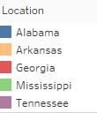
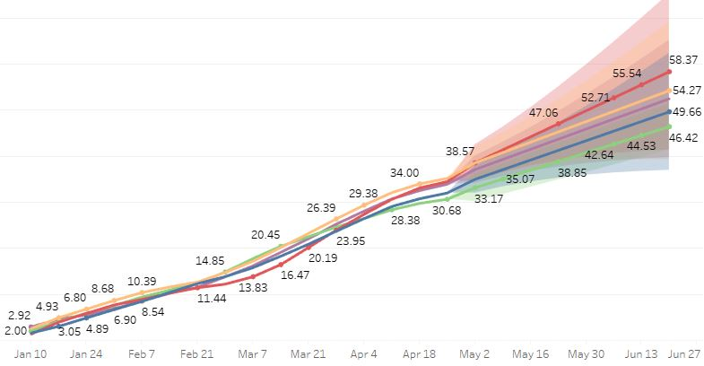
States with the lowest projected vaccinated population
The states with the lowest number of vaccines per 100k are Alabama, Arkansas, Georgia, Mississippi and Tennessee. If these trends continue by June all of these states will still be below 60%.

